Slide 1
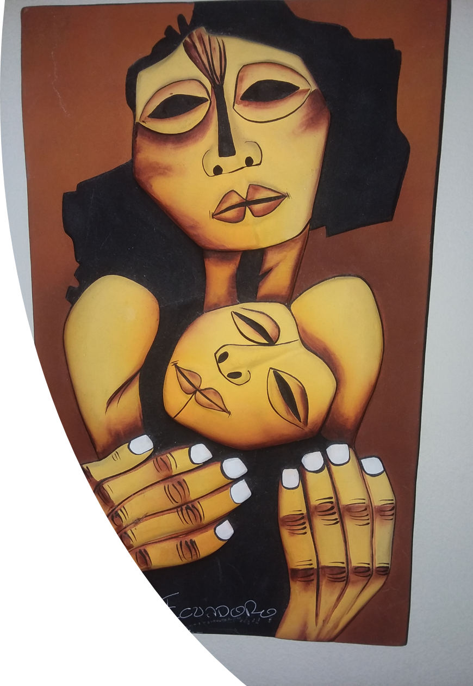
Cultural Considerations in Engaging the Latinx Community: Cultural Humility, Resilience and Mental Health Part III
Ingrid Ramos, LPC
Bienestar & Resilience Programs Director
The Women’s Initiative
May 30, 2019
Panelists:
Dr. Vivian Rodriguez, Psychologist
Fanny Smedile, President Sin Barreras

Slide 2
Objectives
Review concept of Cultural Humility
Provide a framework from which to understand aspects of Latino culture that contributes to their resilience and acculturation stress
Present issues of mental health and migration
Offer Ideas for engagement
Highlight examples of practice in cultural humility and collective resilience

Slide 3
Cultural Humility Framework
A process of life-long learning and compassionate self-reflection
A commitment to recognize and mitigate power imbalances
A commitment to institutional accountability
Each one of us is a complicated, multidimensional human being

Slide 4
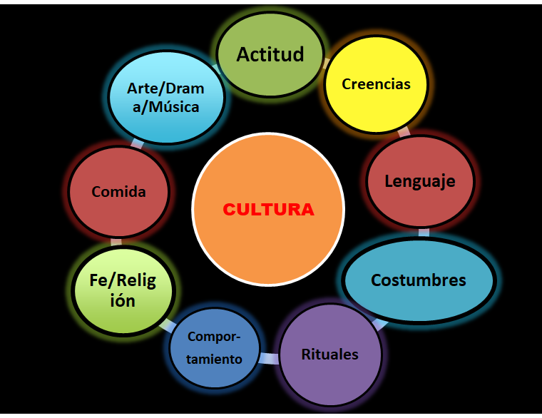
Values
Beliefs
Attitudes
Customs
Time orientation

Slide 5
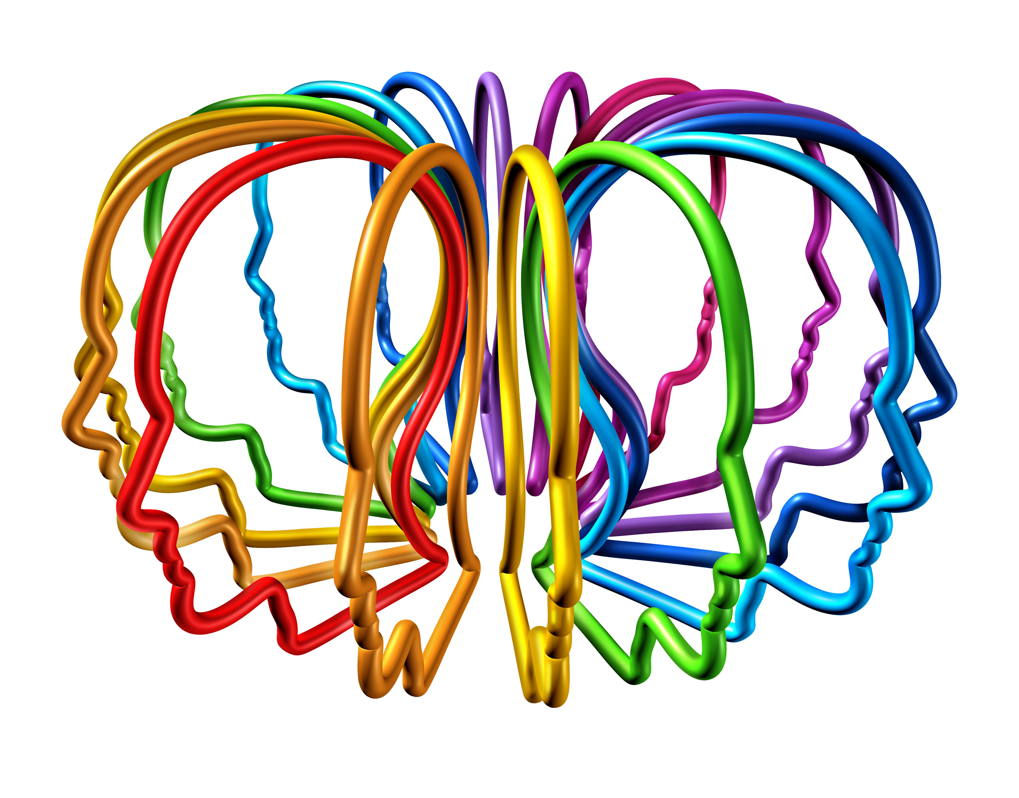
Multidimensions of Culture and Individual Differences
"Culture only demonstrates collective patterns of beliefs, behaviors and values of people who belong to the culture, this does not mean that people of the same culture feel and act in the same way. Instead, there is a great individual difference within members of the same cultural group, and that’s due to the varied and complex factors that shape a person's life".
(Dr. Him, 2014, p.54)

Slide 6
Regionality
Ethnicity
Ability
Class
Age
SELF
Gender
Nationality
Race
Sexual
Orientation
Religion

Slide 7
Hispanics Latinos Latinxs
Who are they?

Slide 8
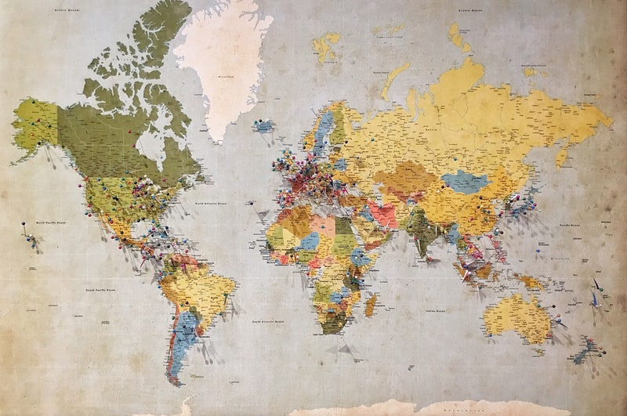
Latinos Hispanics Latinx
20 Countries- Spanish & Portuguese
More than 500 Million People
Mix- Native Indians, African descendants
And Spanish immigrants
Notes:
America in 15th Century: Inhabitants that probably migrated from Africa, Asia, and Austraulia about 10,000 years ago who established
Themselves though out North, Central, and South America and the Caribbean with diverse culture, religion, and political structure.
Christopher Columbus arrived in 1492 and named this vast group of people “Indians” because he thought he arrived to Asia.
Latinos- multicolor and multiethnic group; the word refer to people from Latin America
Hispanic- refers to language people that speak Spanish and countries that were ruled by Spain; used by USA since 1970 to group people whose origins are of Mexican, Puerto Rican, Cuban, Central or South American (This is not refering to race)
Latino generally refers to countries (or cultures) that were once under Roman rule. This includes Italy, France, Spain, etc. Brazilians are considered to be Latino, but are not considered to be Hispanic.
Conclusion: It is better to ask Where are you from? People like to be identify with their country of origin: Mexican, Dominican, Peruvian, Brazilian, etc.
Representing more than 20 countries and more than 500 million people

Slide 9
Cultural Competence Cultural Sensitivity Cultural Humility
“This diversity invites clinicians to practice humility and
recognize that the pathways to emotional, cognitive, relational,
and spiritual development among Hispanics are many because
“cada persona es un mundo” (each person is a world in his or
her own right). (Smith & Montilla)

Slide 10
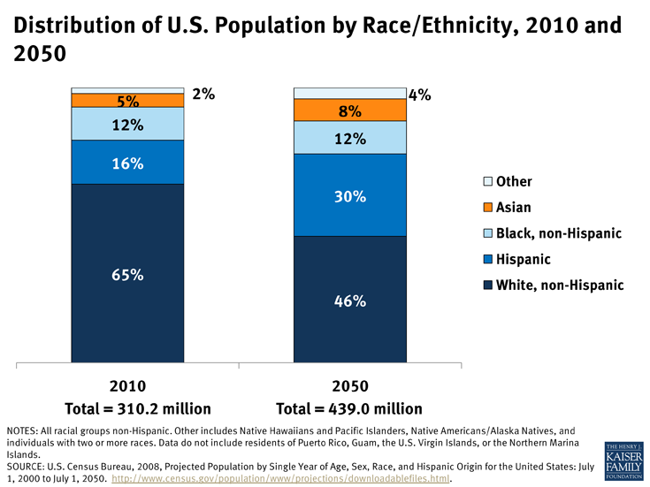

Slide 11
Population- Census 2010
Jurisdiction | Total Population | Hispanic | %
Albemarle County | 98,970 | 5,417 | 5.5%
Charlottesville City | 43,475 | 2,223 | 5.1%
Jurisdiction | Total Population | Hispanic | %
Virginia | 8,001,024 | 631,825 | 7.9%
From: http://www.coopercenter.org/demographics/Hispanics-in-Virginia

Slide 12
Latinx Resilience
Family and community connection
Spirituality
Work ethic/ desire to move forward in life for the wellbeing of the family

Slide 13
Cultural Values and Mental Health

Slide 14
Cultural Values Orientation
Table 4. Contrasts in Emphasis between Common Collectivistic and Individualistic Values
Continuum of Values
Collectivistic | Individualistic
Interdependence | Independence
Obligations to others | Individual rights
Rely on group | Self-sufficiency
Adhere to traditional values | True to own values and beliefs
Maintain traditional practices | Continuously improve practices (progress)
Fulfill roles within group | Pursue individual goals/interests
Group achievement | Individual achievement
Competition between groups | Competition between individuals
Group or hierarchical decision-making | Self-determination and individual choice
Shame/guilt due to failing group | Shame/guilt due to individual failure
Living with kin | Independent living
Take care of own | Seek help if needed
Property shared within group | Strong individual property rights
Elders transmit knowledge (often oral) | Individuals seek knowledge (often textual)
Objects valued for social uses | Objects valued for technological uses

Slide 15
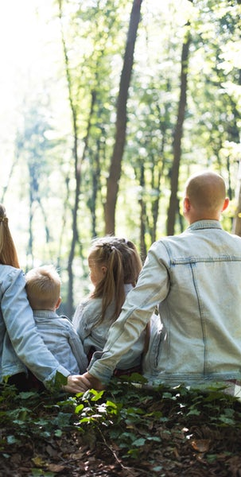
Latinx Values
Collectivism- Latinos value each person dignity and individual nature, but they thrive in caring for each other and maintaining the communal relationship. They are relationship oriented. Healing happens in connection not in isolation.
Familism
Personalism
Politeness
Respeto

Slide 16
Latinx Values
Familism- loyalty, solidarity, cooperation and interdependence.
Inclusiveness and participation in large family networks: sense of belonging and pride
Family is first then the individual needs.
Problems and conflicts stay in the family
You move toward the family, not away from the family
Boundaries are flexible in the nuclear family to include aunts, uncle, grandparents and cousins

Slide 17
Latinx Values
Personalism- people are important.
People are more important than things
Warm and friendly interactions
“Mi casa es su casa”
High level of emotional involvement and resonance with the family
Notes:
Implications: if you are a counselor, you become family. People might bring food or gifts to you. Counselors might find themselves self-disclosing a little bit more than when working with Americans clients.
Politeness- Amabilidad/ civility/ embedded in the Spanish language. Need to explain a lot/openness.
Simpatia- Promotion of warm/ smooth interaction; conformity and empathy for others’ people feelings; avoidance of conflict or negative remarks. Use of indirectas, choteos (jokes), and dichos.

Slide 18
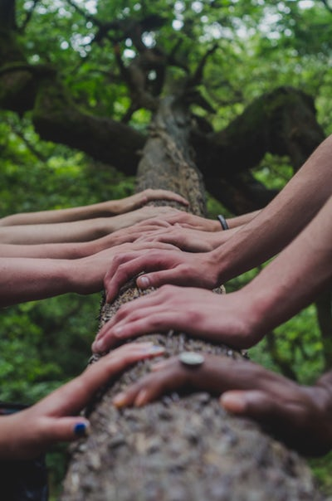
The Latinx Family- Roles
Family rituals: gathering on a weekly basis
Unquestionable authority of parents
Respeto-
Mothers- mixed blessings: honor to pass on the family traditions and ways. Self-denial and abnegation. Dedication to her husband and children.
Father- protector/ provider/ disciplinarian- no involve in daily caretaking activities
Siblings- ties are strong and include cousins.
Notes:
“highly emotionalized dependence and dutifulness within a fairly authoritarian framework”
(Diaz-Guerrero as cited by Falicov)

Slide 19
Mental Health
“Mental health is defined as a state of well-being in which every individual realizes his or her own potential, can cope with the normal stresses of life, can work productively and fruitfully, and is able to make a contribution to her or his community.”
World Health Organization
Notes:
Mental illness: health condition that impacts our thoughts, emotions and behaviors. Severity of symptoms impacting the way somebody functions and make decisions in life.

Slide 20
Latinos Mental Health- Facts
Research shows that Latinos are especially vulnerable to the stresses of immigration and acculturation
More Latino youth have pervasive feelings of sadness and hopelessness than white:
36% vs. 26%
American Psychiatric Association/Mental Health Disparities: Hispanic/Latinos
APA Fact Sheet-https://www.centerforaddictionrecovery.com/addiction-news/Fact-Sheet---Latinos.pdf

Slide 21
Disparity
Among Hispanics with a mental disorder:
Fewer than 1 in 11 contact a mental health specialist
While fewer than 1 in 5 contact a general health care provider
A National Study:
36% of Hispanics with depression received care vs. 60% of white
Mental Health Providers:
1 in 5 Americans identifies as Hispanic, but only 1% of psychologist identified themselves as Hispanic (APA, 2005)

Slide 22
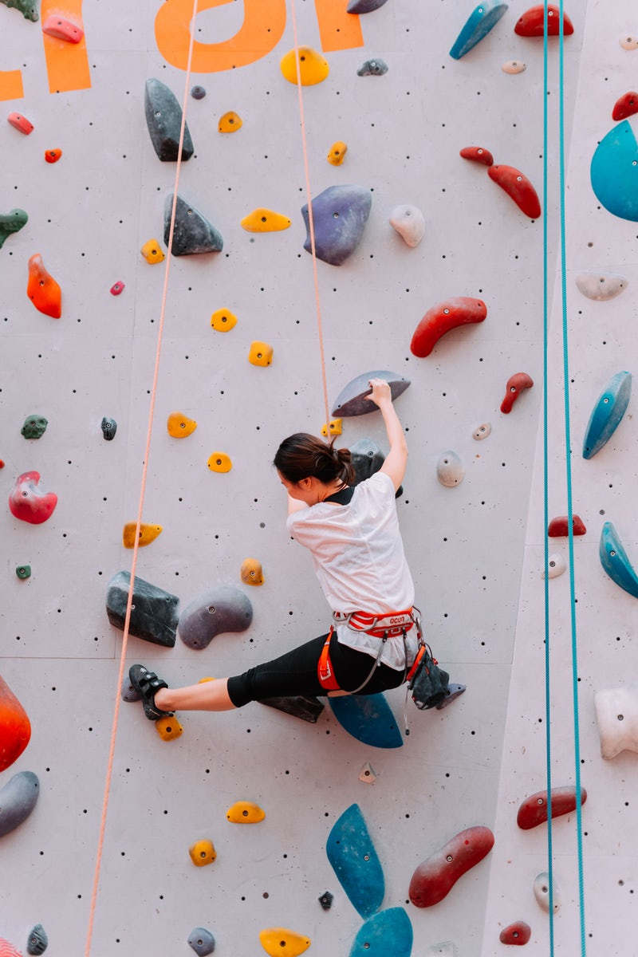
BARRIERS/ CHALLENGES

Slide 23
Individual Barriers
Stigma associated with mental health problems
“I am not crazy” (level of care in LA)
Cultural barriers
Beliefs about mental health: Fate/God
Masculinity
Male’s view: “Weak individual exposing their family”
Violence and trauma
Violence in the home limiting access
or violence in in country of origin contributing to PTSD
Lack of knowledge and awareness about the mental health system
Signs of mental illness
Where to go/ how the system works
Community-Defined Solutions for Latino Mental Health Care Disparities/California Reducing Disparities Project, Latino Strategic Planning Workgroup Population Report- https://www.ucdmc.ucdavis.edu/newsroom/pdf/latino_disparities.pdf
Notes:
Youth: Lack of mental health services at schools to deal with hx of trauma for youth that is coming to US running from violence/gangs, putting them at risk for acculturation stress, drug use, gang involvment, teen pregnancy and dropping out of school.

Slide 24
Community Barriers
Lack of culturally and linguistically appropriate services
Lack of qualified mental health professionals
Lack of academic and school-based mental health programs

Slide 25
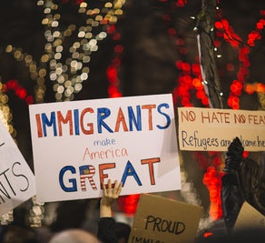
Issues related to Immigration
Voluntary or involuntary migration
Family separation/reunification
Trauma in country of origin
Trauma crossing the border
Cultural Adjustment
Language
Cultural norms
Ways of relating to others
Resources
Experienced or perceived discrimination

Slide 26
Structural/ Systemic Barriers
Anti-immigrant sentiment
Racism/ Discrimination
Inequality and violence in country of origin
Difficult immigration laws and system

Slide 27
Reverse Acculturation- What can we learn?
Return to Mexico PBS News Hour
https://www.pbs.org/video/return-to-mexico-1558394517/
Notes:
Start at 3:30

Slide 28
Collective Resilience

Slide 29
Latinos’ Beliefs about Coping
Fatalism-There is little in life under one’s control. (External locus of control). “Si Dios quiere”
Coping Mechanism- “Hay que poner de su parte”
Controlarse- control your emotions
No pensar- Don’t think
Resignarse- Resignation
Sobreponerse- Overcome
Notes:
Falicov (2014): Deficit oriented theory vs. Resource oriented theory
Learned hopelessness: socioeconomic issues
Spirituality, religion and faith are the ways of Latino maintaining connection with nature, universe and self. Source of resiliency.

Slide 30
Latinos' Beliefs about Support
Spirituality is at the center of their lives:
Religion (Catholicism/Protestantism)
Curanderismo
Santeria
Espiritismo
When facing problems the tendency is to seek help from:
Family
Curanderos or clergy
Primary care provider
Use of herbal medicine

Slide 31
How to foster engagement?

Slide 32
Implication for Mental Health
Therapeutic Relationship
Build trust and rapport: relationship requires time.
Use conversational approach to gather information. If you have to fill out a form, take time to explain what you are doing and the purpose, how long it will take.
Initial reservations don’t mean resistance
Ask how the person perceives the problem- self explanation theory
Politeness might imply that the person is saying “yes” when he/she might be thinking differently

Slide 33
Implication for Mental Health
Check for body language, provide permission to express a different opinion, create “check in point” throughout the conversation
Assessment: migration story and its implication, aware of issues of trauma and symptoms, issues of isolation (identify support system)
PTSD- somatization of symptoms/frequency of visits to the hospital/emergency visits
Organizational/ Agency
Language access: bilingual staff, interpreters, voicemail, forms
Have a point person- provide first name
Provide appointments in written form
Cultural competence evaluation and training for all staff

Slide 34
Engagement in Services
Trust:
It is not achieved by doing, but by the gradual development of the relationship- Personalismo
Interactions marked by showing genuine interest in the person, might require some self-disclosure
Might take 5 extra minutes at the beginning, but can accelerate your work in the future
Transparency about the purpose of meeting and procedures
Treatment-
Family oriented
Psychoeducation using biological explanations
Explanation about level of care and prognosis
Cooperation among community service providers

Slide 35
Cultural humility Approach
Ask questions, in a humble, safe manner
Seek self-awareness
Suspend judgment
Express kindness and compassion
Support a safe and welcoming environment
Start where the client is at
Retrieved from: National Association of County and City Health Officials
http://calwic.org/storage/documents/conference/2016/Cultural%20Humility%20CWA.pdf
Notes:
To look at ourselves in a humble manner requires vulnerability and to be in
Relationship with others requires to be grounded in an space of mutual
Respect that can help us deal with the unknown while remaining connected
Brene Brown video on sympathy vx. Empathy can help us illustate this stand.

Slide 36
How to address power Imbalance?
Reducing power differential in the relationship between client and provider
Emphaizing client's strenghts and resilience
Framing the relatioship as cooperative and co-learning between the provider and the client
Richard, S. (2016)
Notes:
It is a cultural shift where the client is seen as the expert in his own life, and the provider can take an stance of mutuality, cooperation, curiosity and humbleness. One who holds the power is the one who takes responsibility

Slide 37
Panel Discussion
Ingrid Ramos, LPC
Dr. Vivian Rodriguez, Psychologist
Fanny Smedile, President Sin Barreras

Slide 38
Resilience and Cultural Humility in Action

Slide 39
Latinx Vision and Dreams in Charlottesville
Promote respect, equality, social justice, cultural understanding, and hermandad
Give a voice to the cultural identity of our community.
Represent our community at both local and state board meetings.
Contribute to the integration, improvement, and wellbeing of the Latinx community in Virginia
Find and strengthen our voices

Slide 40
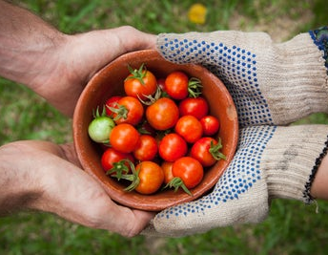
Latinx Vision and Dream in Charlottesville
Our community will be able to:
Recognize and embrace cultural diversity within the Latinx culture.
Integrate and navigate new cultures without abandoning their roots.
Feel secure in participating in and utilizing available resources.
Improve quality of life as well as education and wellbeing.
Come together as a diverse community with the common goal of creating an inclusive society with opportunities for all.

Slide 41
Provide a Bridge for Cultural Understanding

Slide 43
References
Adames, H.Y., Chavez-Dueñas, N. Y. (2017). Cultural Foundations and Interventions in Latino/a Mental Health, History, Theory and Within-Group Differences. Routledge Taylor & Francis Group.
Alegria, M., Canino, G., Shrout, P.E., Woo, M., Duan, N., Vila, D., Torres, M., Chen, C., Meng, X. (2008). Prevalence of mental illness in immigrant and non-immigrant U.S. Latino groups. NIH Public Access Author Manuscript, 165 (3): 359-369.
American Psychiatric Association/Mental Health Disparities: Hispanic/Latinos
APA Fact Sheet-https://www.centerforaddictionrecovery.com/addiction-news/Fact-Sheet---Latinos.pdf
Community-Defined Solutions for Latino Mental Health Care Disparities/California Reducing Disparities Project, Latino Strategic Planning Workgroup Population (2012) (Report- https://www.ucdmc.ucdavis.edu/newsroom/pdf/latino_disparities.pdf
Corona, K., Campos, B., Chen, C. (2016). Familism Is Associated With Psychological Well-Being and Physical Health: Main Effects and Stress-Buffering Effects. Hispanic Journal of Behavioral Sciences, Vol. 39 (1) 46-65.
Falicov, C.J. (2)014. Latino Families in Therapy, Second Edition. The Guilford Press.
Kramer, E.J., Guarnaccia, P., Resendez, C., Lu, F.G. (2009). No Soy Loco/I’m Not Crazy, Undertanding the Stigma of Mental Illness in Latinos.

Slide 44
References
Mental Health America- Latino/Hispanic Communities and Mental Health
http://www.mentalhealthamerica.net/issues/latinohispanic-communities-and-mental-health
Organista, K.C. (2007). Solving Latino Psychosocial and Health Problems, Theory, Practice and Populations. John Wiley & Sons, Inc.
Smith, R.L., & Montilla, R.E. (2006). Counseling and Family Therapy with Latino Populations, Strategies that Work. Routledge Taylor & Francis Group.
Wassertheil-Smoller, S., (2014). Largest Study of Hispanics/Latinos Finds Depression and Anxiety Rates Vary Widely Among Groups. Einstein Hispanic/Latino Health.
Wassertheil-Smoller, S., Arredondo, E., Cai, J., Castenada, S., Choca, J.P., Gallo, L., Jung, M., LaVange, L.M., Lee-Rey, E.T., Mosley, Jr., T., Penedo, F.J., Santistaban, D., Zee, P. (2014). Depression, anxiety, antidepressant use, and cardiovascular disease among Hispanic men and women of different national backgrounds: results from the Hispanic Community Health Study/Study of Latinos (HCHS/SOL). NIH Public Access Author Manuscript, 24(11): 822-830.

