Slide 2
Community Investment Collaborative CIC
CIC is a micro-enterprise development organization founded in 2011
Our mission is to strengthen the community by fueling the success of under-resourced entrepreneurs through education, mentoring, micro-lending and networking.
cicville.org

Slide 3
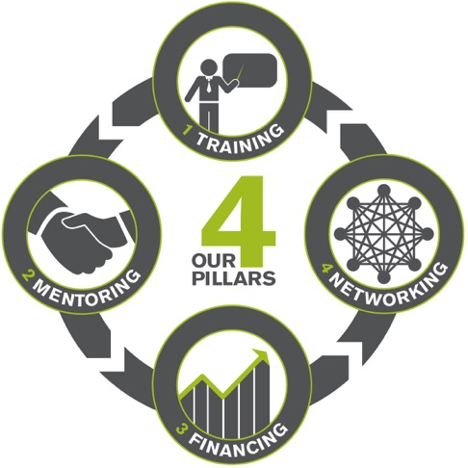
CIC is built on four pillars:
cicville.org

Slide 4
17-week program
54% of WIBO graduates are still successfully operating their businesses 5 years after the program
cicville.org

Slide 5
The Curriculum
Basic Requirements & Getting the Facts: Market Research
Identifying Your Target Market: The Message
Promoting Your Business: The Marketing Campaign
Searching for Customers: Prospecting
(Non-WIBO) Personal Branding & Communications
Helping People Buy: Sales
Making a Profit: Pricing Strategy
Making a Profit: Costs
Making a Profit: Financial Decision Making
Making a Profit: Purchasing
Financing Your Business Growth: Cash Flow & Credit
(Non-WIBO) Presenting Your Business for Financing
Investing in People: Human Resources
Using Other People’s Money: Financing,
Controlling Finances: Recordkeeping & Taxes
Assuring Lasting Success: Ethics & Law // Licensing Requirements
Ensuring Economic Independence: Personal Finance
Notes:
There are 17 classes…?

Slide 6
Workshop Format
Tuesdays 6-9pm
Downtown Charlottesville
Workgroups
First half of class
Entrepreneurs break into small groups
Discuss previous weeks homework
Discussion
Second half of class
Full class discussion
Discussion topic follows curriculum each week
cicville.org

Slide 7
CIC Also Provides
Financing
Mentoring
Networking
cicville.org

Slide 8
Financing
Opportunities
CIC Financed Loan
Requires CIC application and approval
<10% interest
1-2 year terms on first loan
Grace periods, flexibility in terms available
Application to loan funds in hand: 4-6 weeks
CIC endorsed Kiva Zip Crowd-funded loans
Requires CIC application and approval
Must raise funds online from your network (10-15 initial lenders), then will have access to national network
0% interest
2 year term on first stage loan
Limited grace periods and flexibility
Application to loan funds in hand: 6-10 weeks
cicville.org

Slide 9
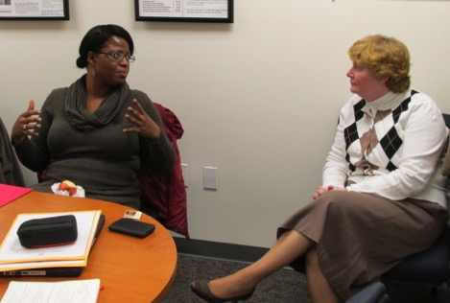
Mentoring
Opportunities
cicville.org

Slide 10
Networking
Opportunities
cicville.org

Slide 11
Thank you!

Slide 12
Contact Information
keir@cicville.org
(434) 218-3481

